Slide 1
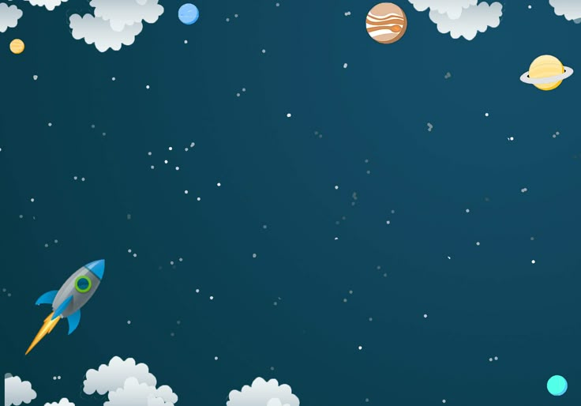
UNIVERSE Allah ‘s masterpiece
BY: nuzzah zubair abdul Rahman

Slide 2
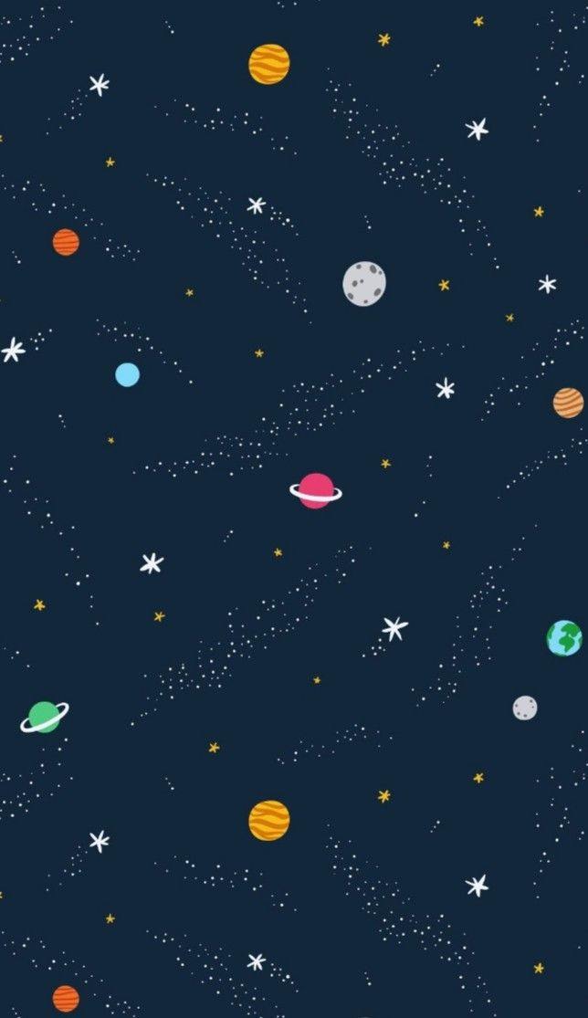
What is universe?
The universe includes everything space ,time , matter and energy. It began with a massive explosion of the universe around 13.8 billion years ago.
Billions of galaxies exists each with millions of stars.The universe might be infinite ,we can only observe a part of it.
Everything is made of atoms and subatomic particles like electrons and neutrons etc. The universe is a vast and fascinating place that has inspired human curiosity for centuries. From the smallest particles to the largest galaxies, it holds countless mysteries waiting to be discovered.

Slide 3
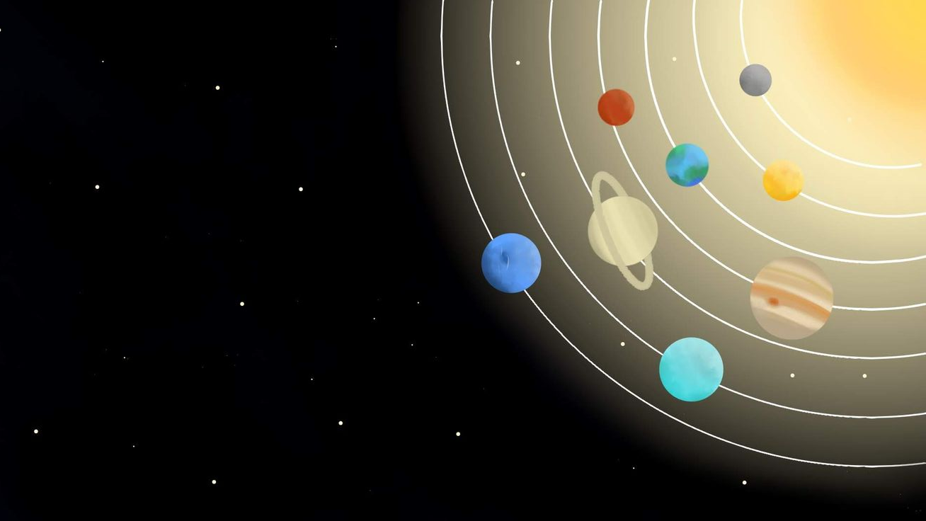
VERSES FROM THE HOLY QURAN ABOUT OUR UNIVERSE
The Creation of the Heavens and the Earth
إِنَّفِي خَلْقِ السَّمَاوَاتِ وَالْأَرْضِ وَاخْتِلَافِ اللَّيْلِ وَالنَّهَارِ... لَآيَاتٍ لِّقَوْمٍ يعْقِلُونَ َ [2:164]
"Indeed, in the creation of the heavens and the earth, and the alternation of the night and the day... are signs for a people who use reason."

Slide 4
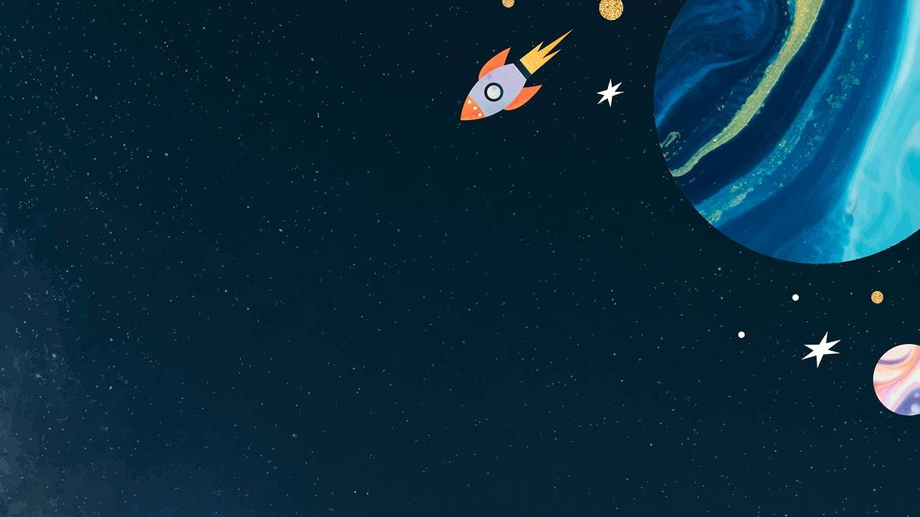
Protective Sky
وَجَعَلْنَا السَّمَاءَ سَقْفًا مَّحْفُوظًا وَهُمْ عَنْ آيَاتِهَا مُعْرِضُونَ[SURAH AL ANBIYA :32]
“And We made the sky a protected ceiling, but they, from its signs, are turning away.”

Slide 5
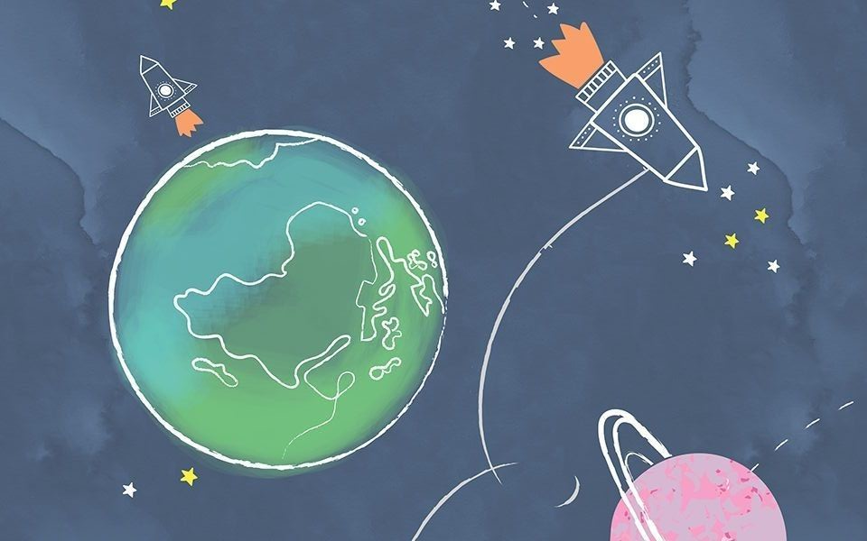
The Heavens and the Earth were Once One
أَوَلَمْ يَرَ الَّذِينَ كَفَرُوا أَنَّ السَّمَاوَاتِ وَالْأَرْضَ كَانَتَا رَتْقًا فَفَتَقْنَاهُمَا وَجَعَلْنَا مِنَ الْمَاءِ كُلَّ شَيْءٍ حَيٍّ ۖ أَفَلَا يُؤْمِنُونَ
"Have those who disbelieved not considered that the heavens and the earth were a joined entity, and We separated them and made from water every living thing? Then will they not believe? "Surah: Al-Anbiya (21:30)

Slide 6
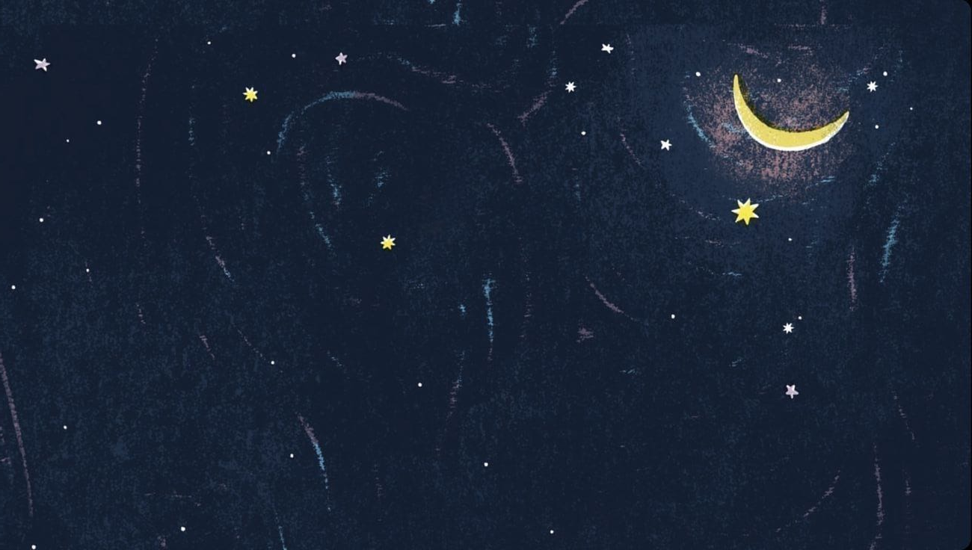
ORBITS OF CELESTIAL BODIES
وَهُوَ الَّذِي خَلَقَ اللَّيْلَ وَالنَّهَارَ وَالشَّمْسَ وَالْقَمَرَ ۖ كُلٌّ فِي فَلَكٍ يَسْبَحُونَ
[21:33]
"And it is He who created the night and the day and the sun and the moon; all [heavenly bodies] are swimming in an orbit."

Slide 7
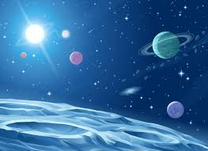
THE UNIVERSE IN THE LIGHT OF QURAN
The qur’an invites us to look at the universe not just with our eyes, but with our hearts and minds. from the stars in the sky to the cycle of day and night, every part of creation is a sign pointing to the wisdom, power, and perfection of allah. these verses remind us that the universe is not random — it is full of purpose, design, and beauty and by reflecting on these signs, we grow in faith, awe, and gratitude towards our creator.

Slide 8
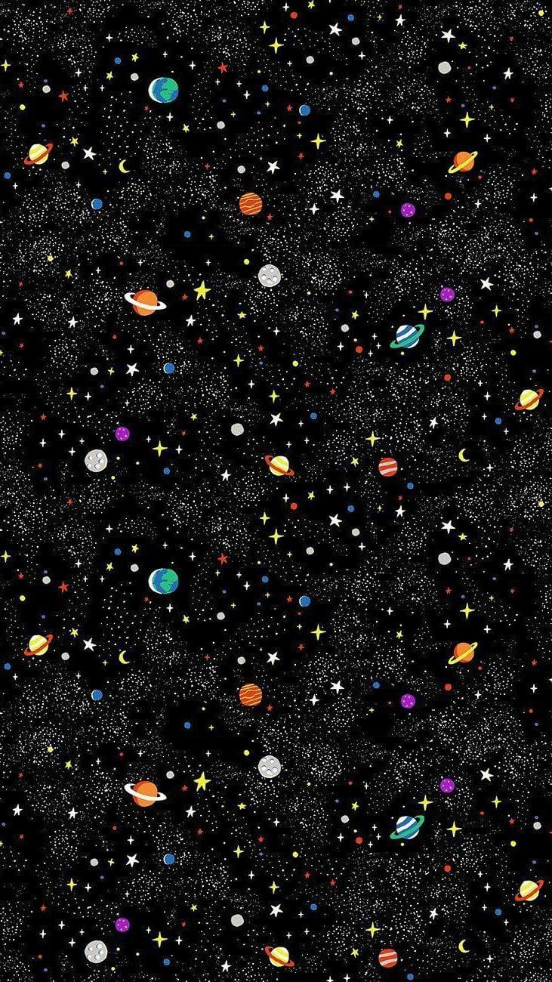
THANK YOU

